Slide 1


De webinar begint over enkele ogenblikken. Zet a.u.b. uw webcam en microfoon uit.
This webinar will begin momentarily. Please turn off your webcam and mic. This webinar will be bilingual Dutch-English. After the webinar there will be a moment for parents to ask questions.
Tip: use the Microsoft translator app to translate to your own language

Slide 2

Webinar: ‘Profielkeuze hoe doen we dat? ’
‘Course selection, how to approach it’

Slide 3

Program
Welcome
Dutch education system explained
Quick introduction to the profiles
How to prepare for chosing
Job shadowing
Tips for parents

Slide 4
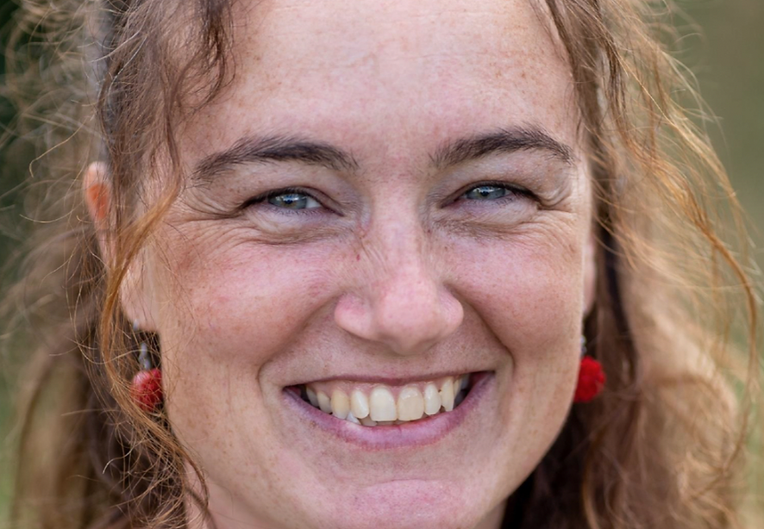
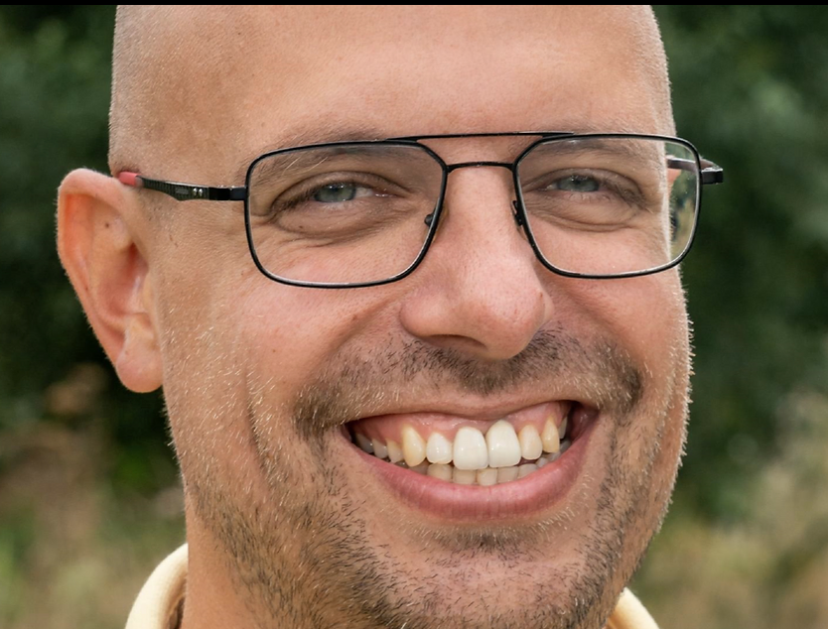


Welcome
Welcome parents and students of Havo 3 and VWO 3
Natasja Jochems
n.jochems@haarlemmermeerlyceum.nl
Student counselor Havo
Art teacher
Patriek Tromp
p.tromp@haarlemmermeerlyceum.nl
Student counselor VWO
Economics teacher

Slide 5
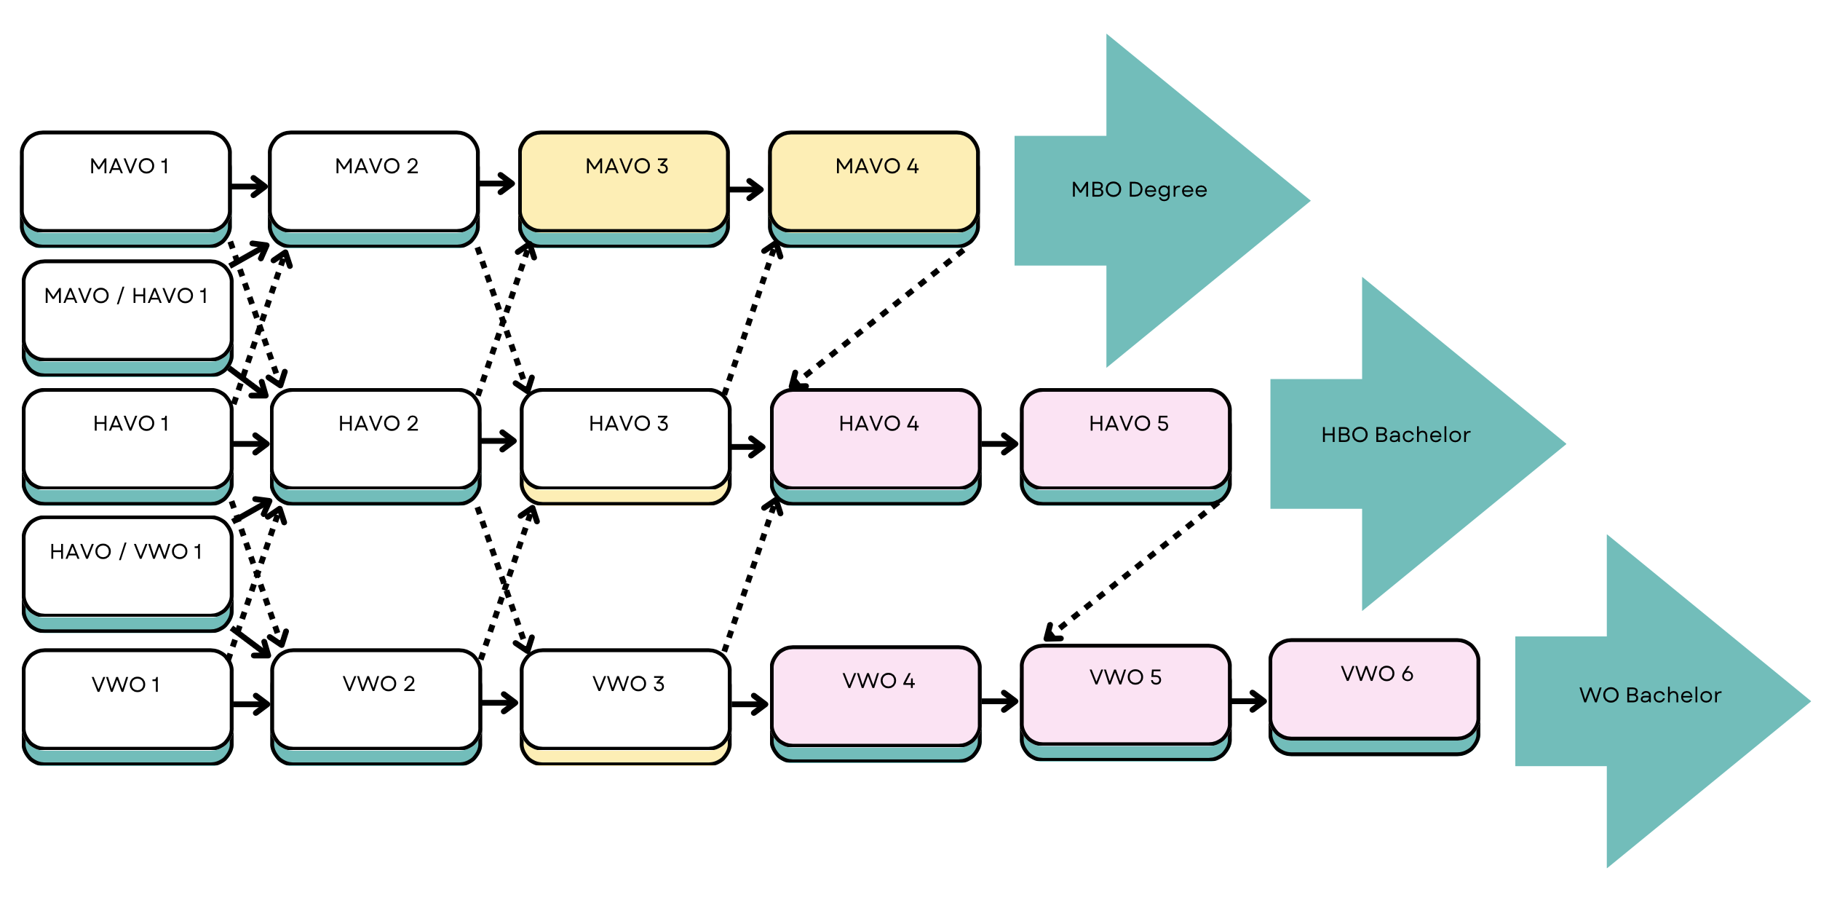

Education system
Check ‘bevorderingsnormen’
Want to compare the grade to international educational systems?

Slide 6
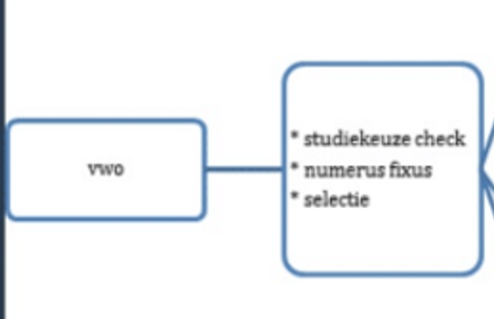
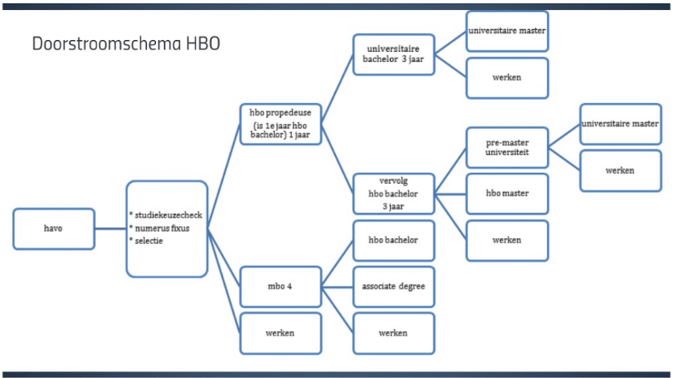
(Higher) education system
MBO
HBO
WO

Slide 7
The ‘profielen’
Cultuur en Maatschappij (culture and society)
      This broad profile focuses on languages, cultures, communication, music, art and social subjects such as law, politics, education, philosophy, history or aid.
Economie en Maatschappij (economics and society)
      Economie en Maatschappij is just like Cultuur en Maatschappij a broad profile. Whereas C&M generally places more emphasis on culture and languages, there is more attention for economic subjects.
Natuur en Gezondheid (Nature and health)
      This profile is aimed at medical and biological disciplines. With this profile you can also take a more technical and scientific side by choosing certain subjects.
Natuur en Techniek (Nature and technique
      This profile has the most exact subjects. This profile not only prepares you for a technical direction, you can also follow courses in, for example, natural, earth and environmental sciences, computer science, health care or technical communication.

Slide 8
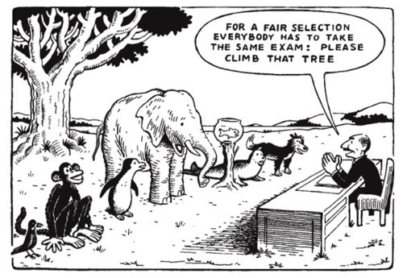
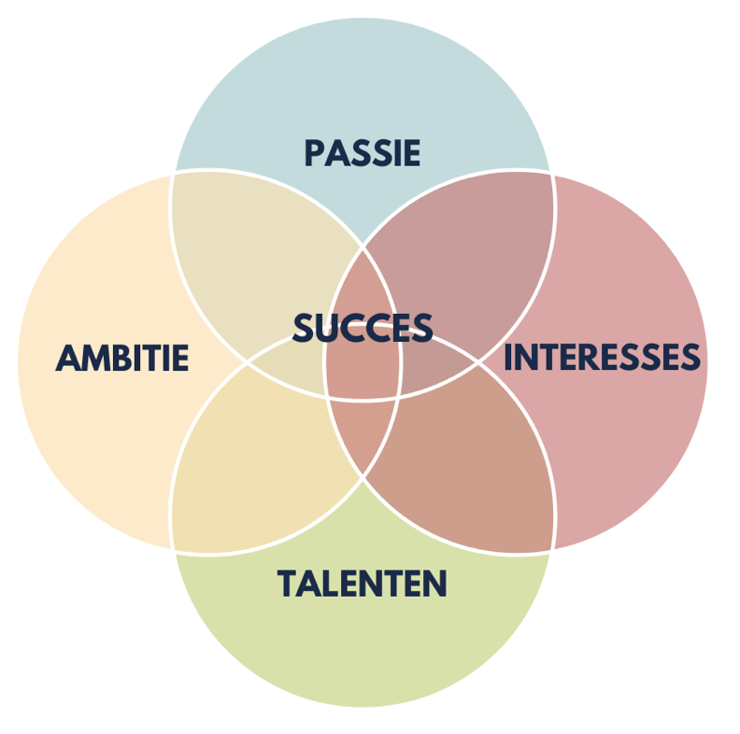

Slide 9
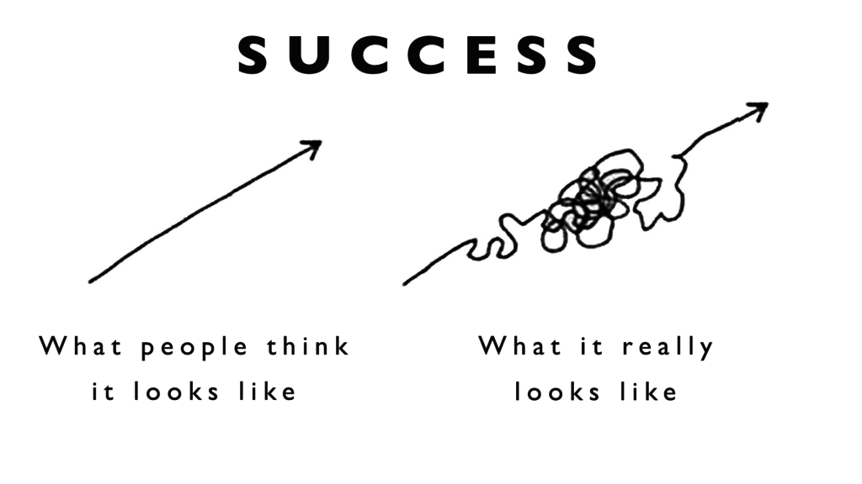

The process
Oktober
Webinar
Mentor lessons on Job shadowing
November
Job shadowing
Mentor lessons on Passion, Ambition, Talents, Interest
Teacher monitor the capacities and ambitions for each subject
December
ILP → talk about Passion, Ambition, Talents, Interest based on experiences
January
Explanation on subjects webinar!
Projectweek
Provisional subject choice
March
ILP meeting → Final subject choice

Slide 10
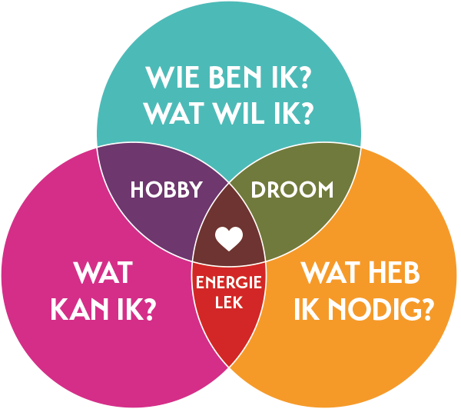
How to pick the right profile?
Consider your child's interests:
Explore what your child genuinely enjoys doing, whether it's school subjects or hobbies. What sparks their curiosity and enthusiasm?
Look at your child's talents:
Identify your child's strengths. What are they naturally good at? Are there particular skills or talents that stand out, such as creativity, compassion, analytical thinking, or communication?
Understand your child's motivations:
Explore what drives your child. Are they motivated by personal achievement, helping others, financial security, or making a difference in the world? Knowing what truly motivates them can guide them toward a study choice that aligns with their core values and long-term goals.

Slide 11
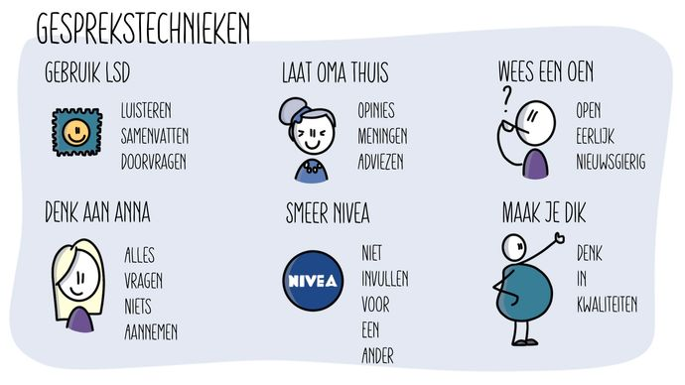

Tips for parents

Slide 12

We’ll worry about subjects later!
Find out if you’re an elephant, a monkey or a fish!

Slide 13


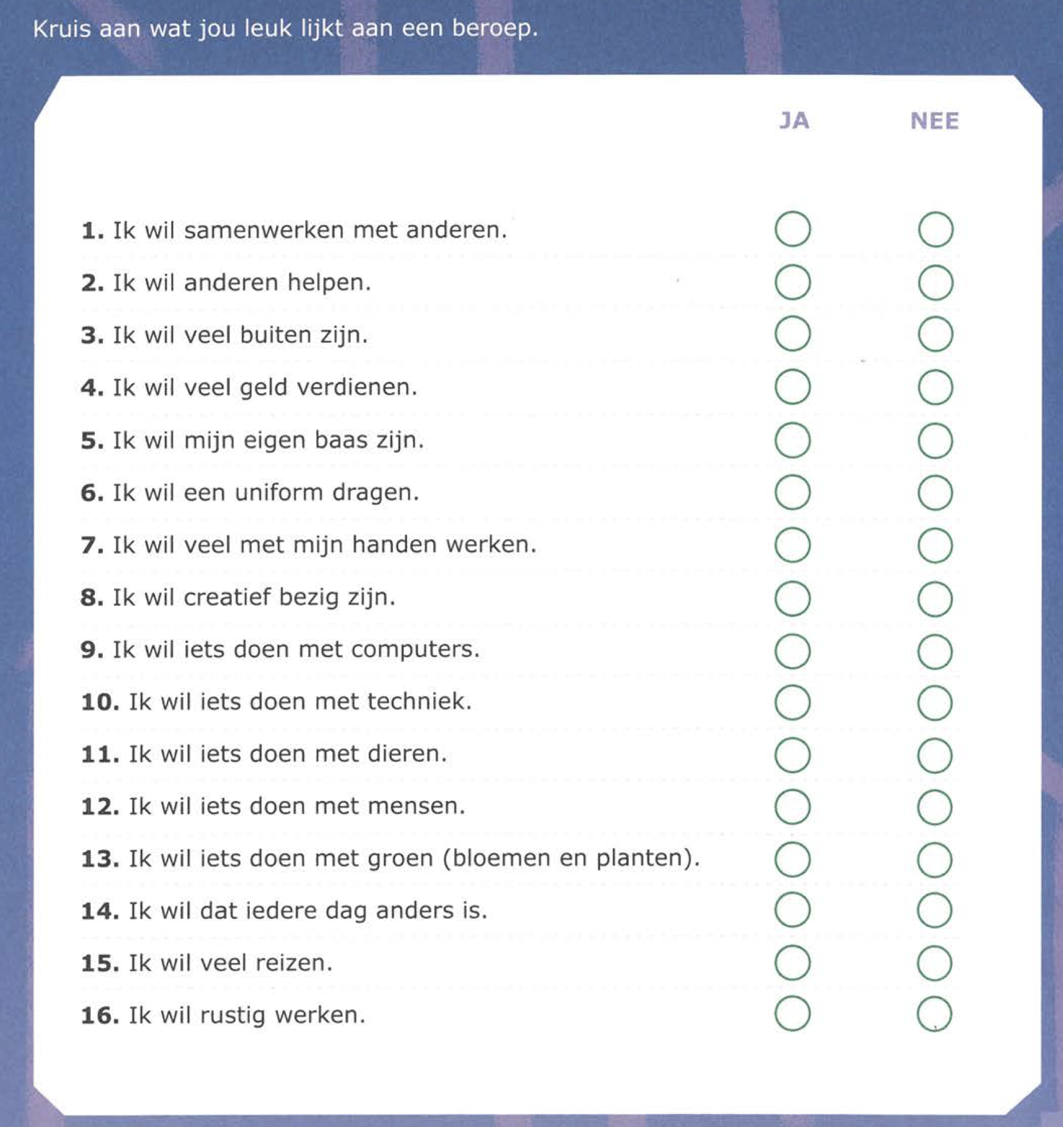
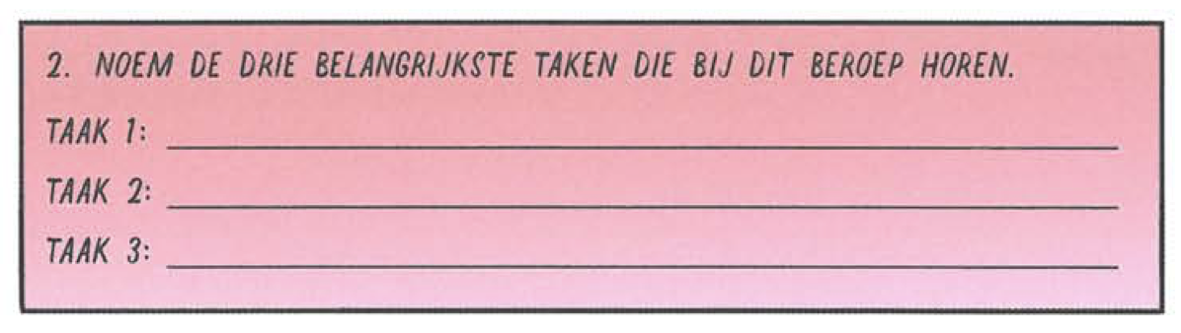

Job shadowing
In the mentor lessons
Preparation before
Evaluation and sharing afterwards
Goals:
Explore new sectors: The internship doesn't need to match current interests, it's about discovering new possibilities.
Develop talents and passions: Entering a new environment with an open mind can help uncover hidden talents and passions.
Practical experiences: Students gain practical experience and explore different sectors by (preparing) spending a day in a real workplace.

Slide 14

Job shadowing – You as a parent
Help in finding an internship:
Any potential place is welcome, not just within your child’s current area of interest. The only requirment is that the it (preferably) has to take place 1 day in week 45, 47 of 48 (november).
Internship Agreement
If desired, an internship agreement is available to formalize the arrangements with the internship location. Send an e-mail to student counselor.
LOB-verlof
Your child will receive LOB leave for the day of the job shadowing.
HAVO → The student has to sign up before october 18th through QR code (provided by mentor, in the booklet)
VWO → ask for leave no later than one week prior to your Job shadowing internship through ‘LOB Verlofformulier’ on website lobhlmltto.com (see tutorial)

Slide 15


Thanks for watching!

Slide 16
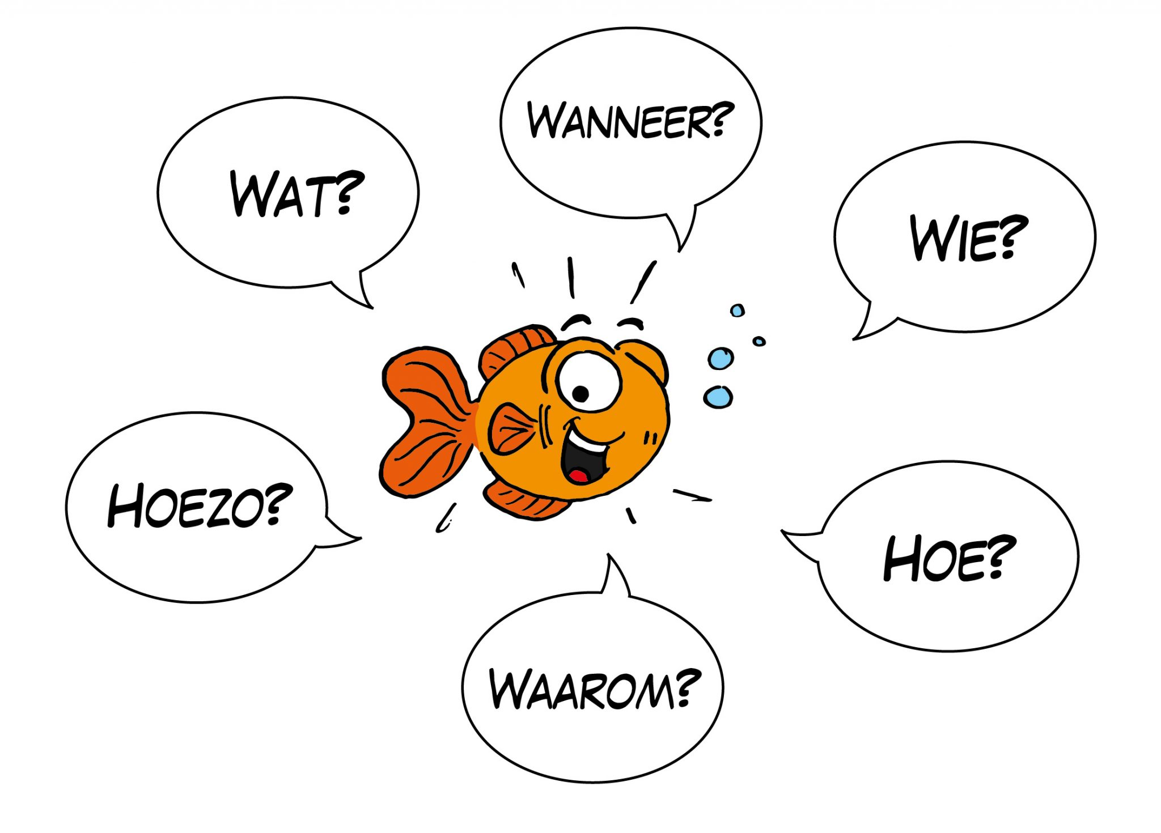
Questions
If you have any questions raise your hand, turn on your mic and webcam and we will gladly answer any questions you might still have

