Slide 1


De webinar begint over enkele ogenblikken. Zet a.u.b. uw webcam en microfoon uit.
This webinar will begin momentarily. Please turn off your webcam and mic. This webinar will be bilingual Dutch-English. After the webinar there will be a moment for parents to ask questions.
Tip: use the Microsoft translator app to translate to your own language

Slide 2

Webinar: ‘Help mijn kind moet een studie kiezen’
‘Help my child find a course’

Slide 3

Program
Welcome
(Higher) Dutch education system explained
What courses to look for
The searching process
Where/how to look for courses
Governmental funding a course
How to sign up
LOB activities at HLML
Important dates
Tips for parents

Slide 4
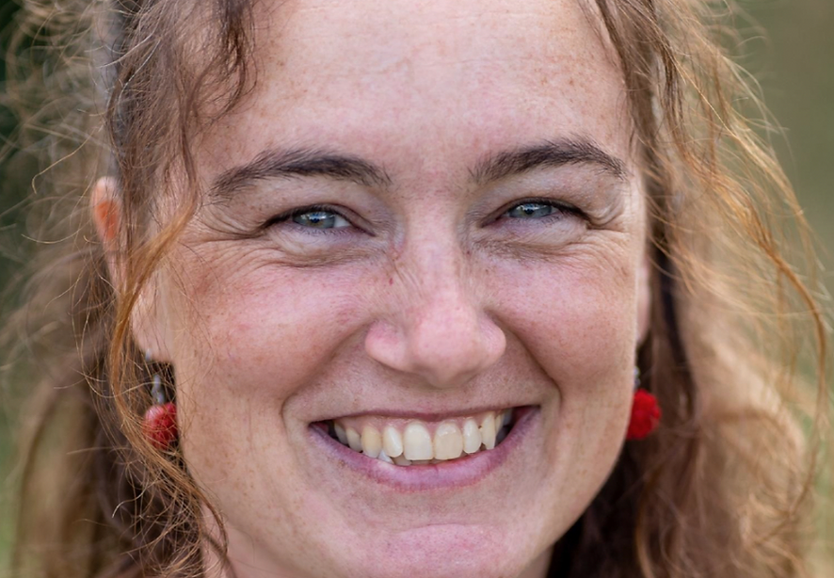
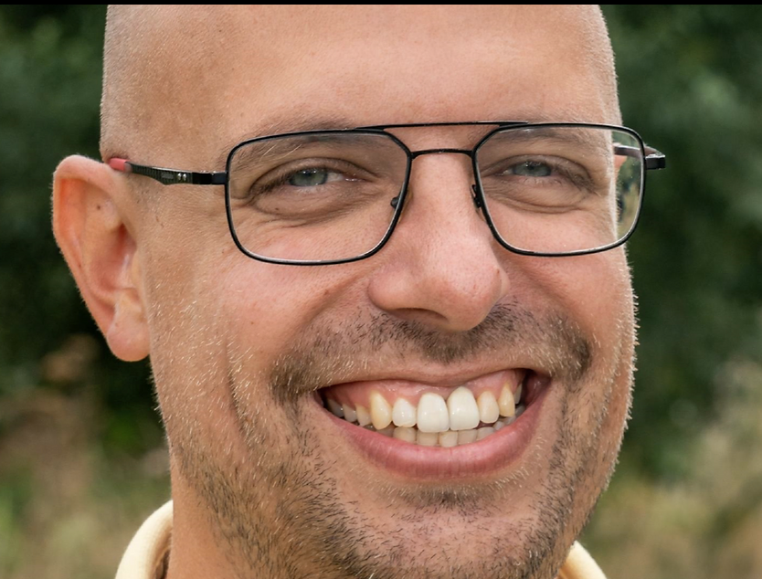


Welcome
Welcome parents and students of H4 – H5 – V4 – V5 – V6
Natasja Jochems
n.jochems@haarlemmermeerlyceum.nl
Student counselor Havo
Art teacher
Patriek Tromp
p.tromp@haarlemmermeerlyceum.nl
Student counselor VWO
Economics teacher

Slide 5
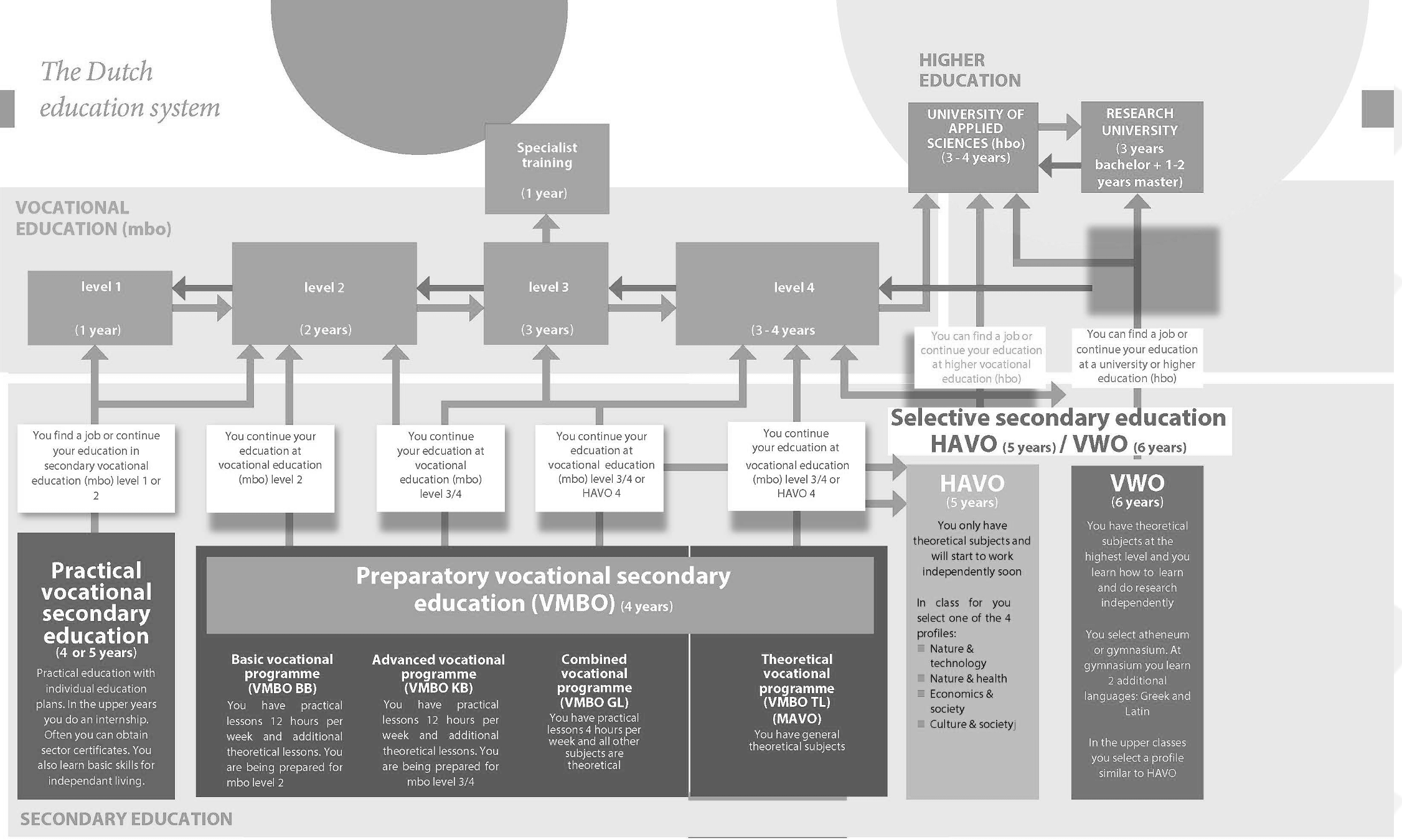
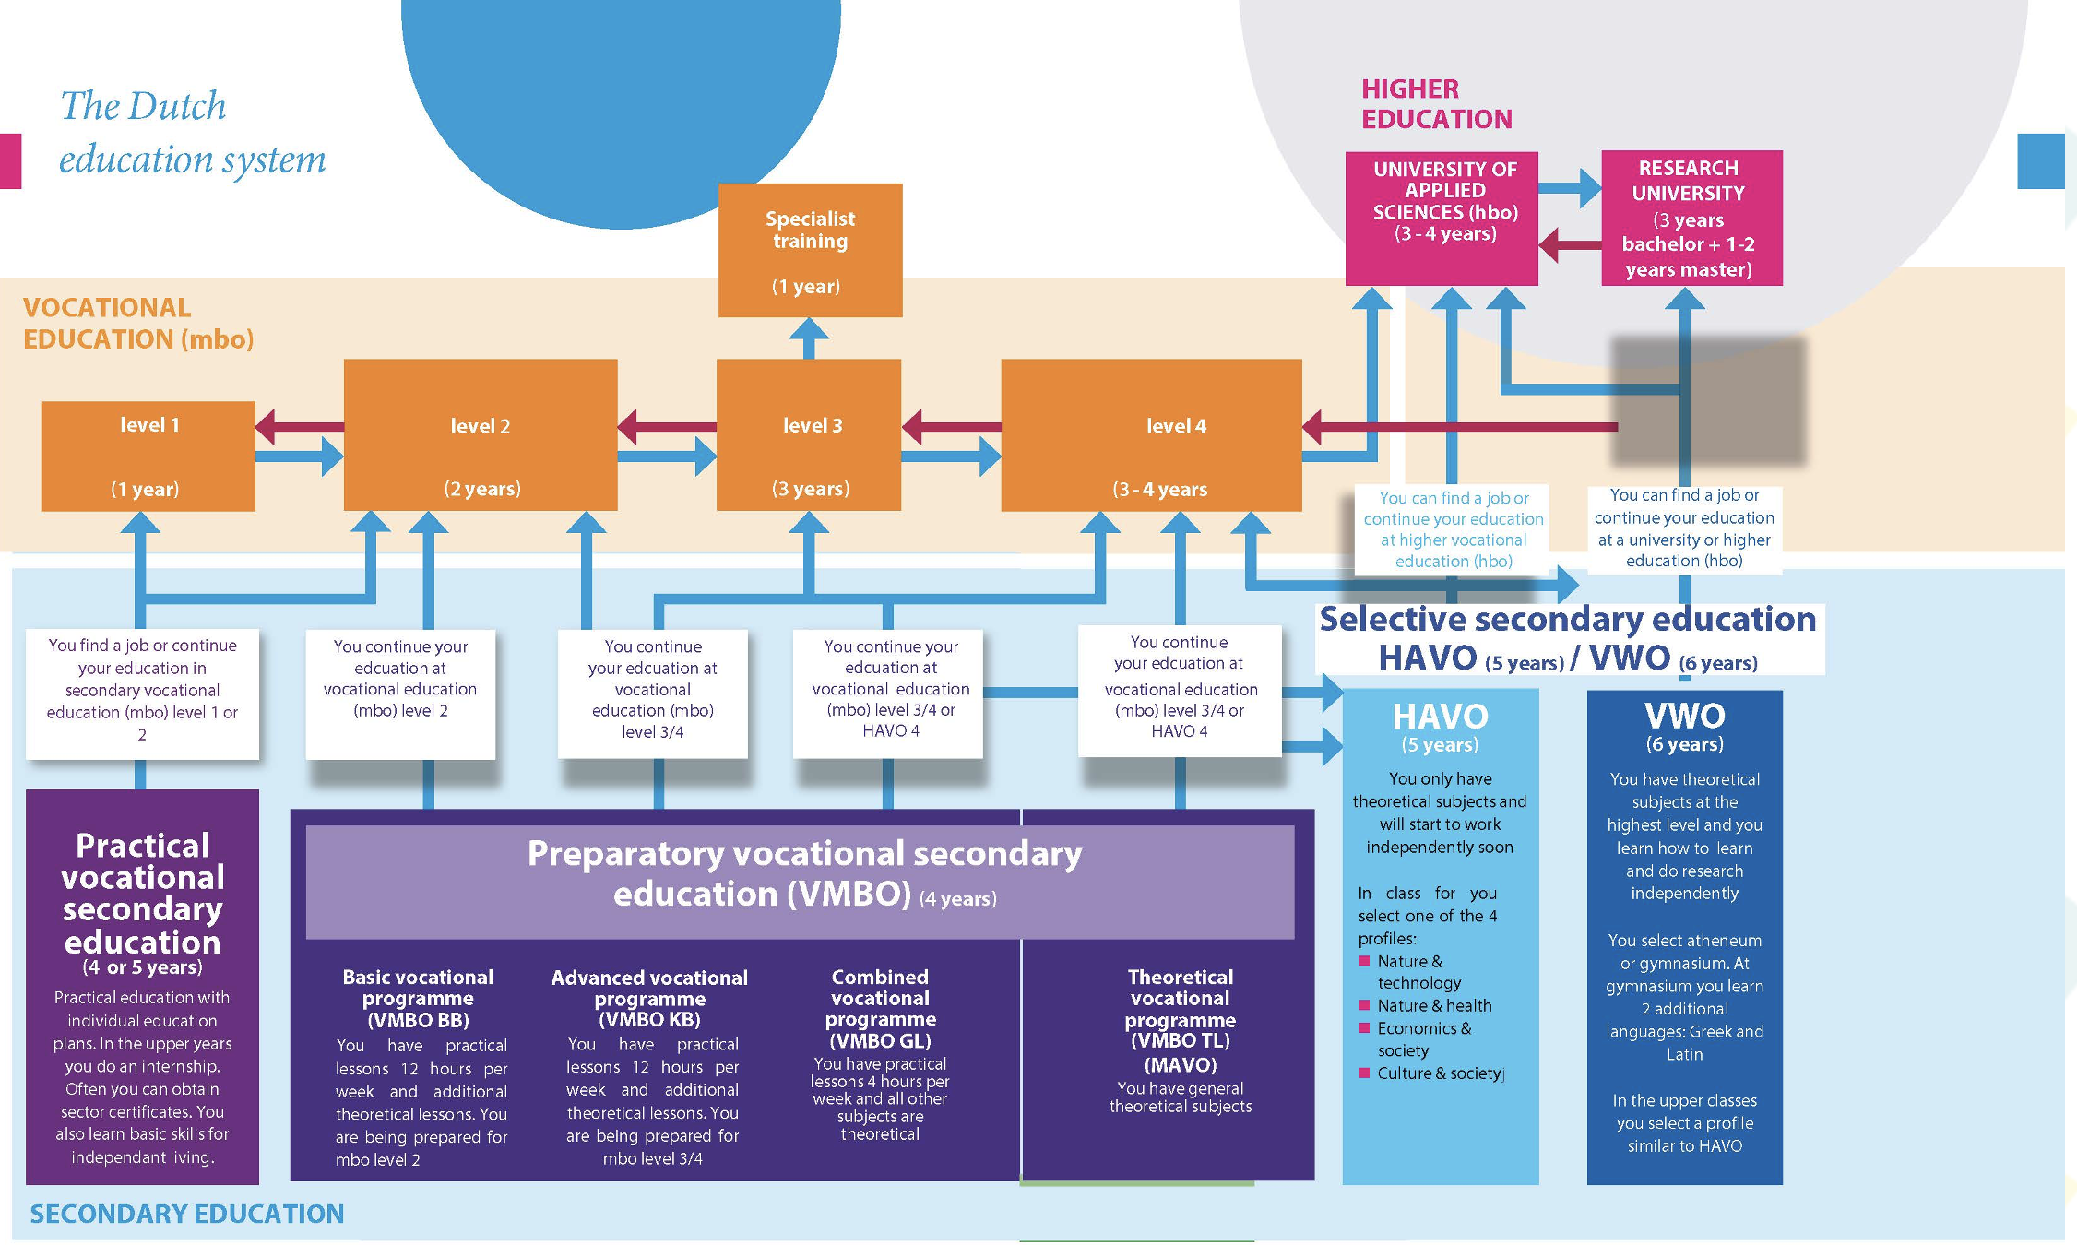
(Higher) education system
MBO
HBO
WO

Slide 6
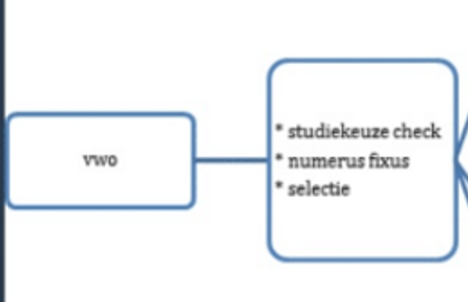
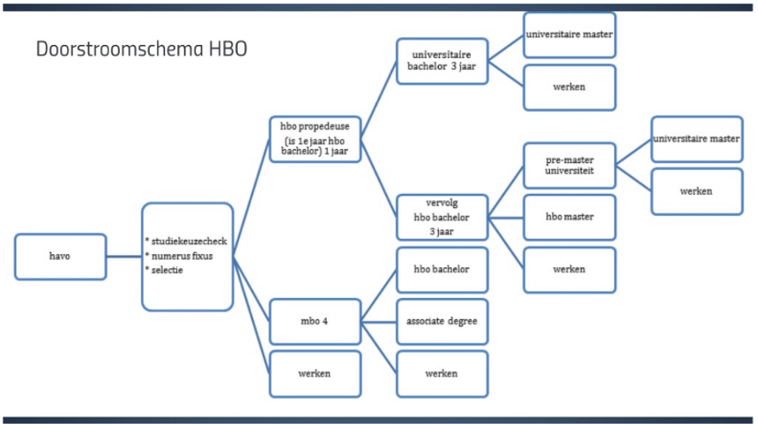
(Higher) education system
MBO
HBO
WO

Slide 7
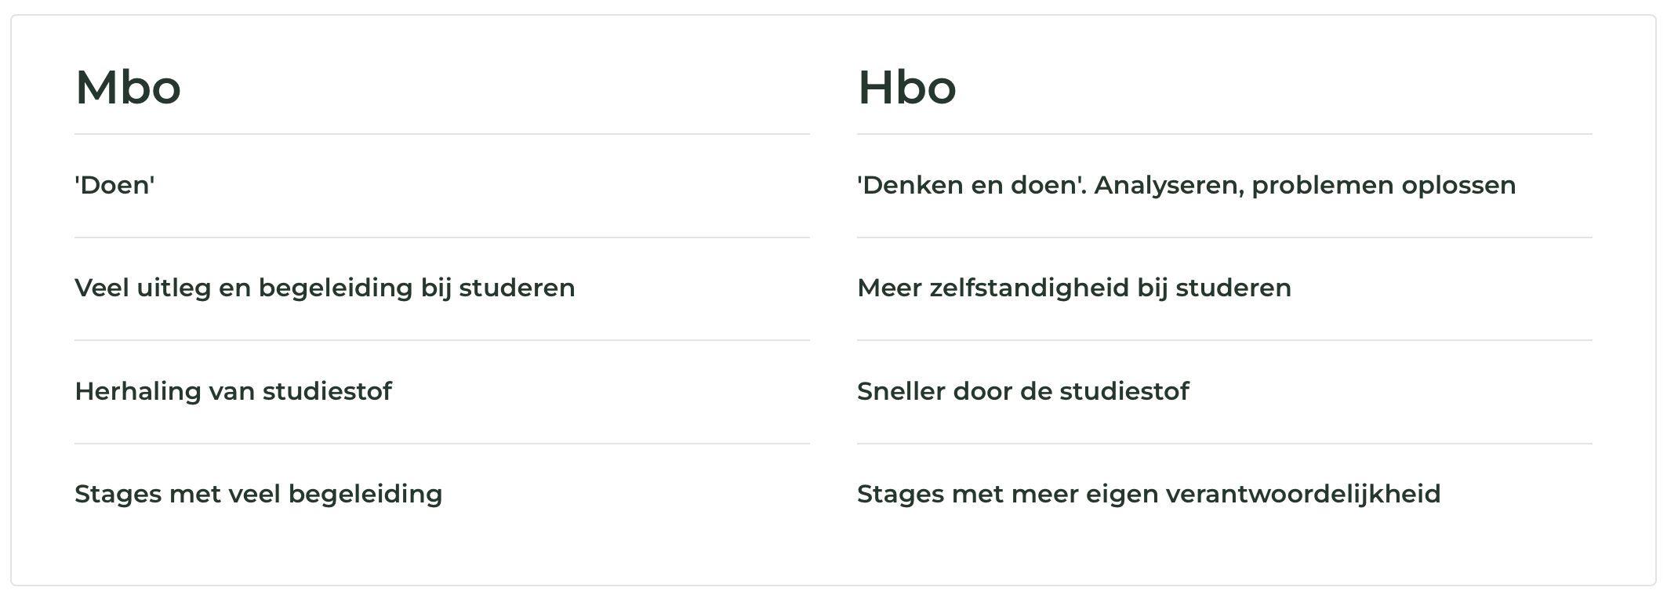
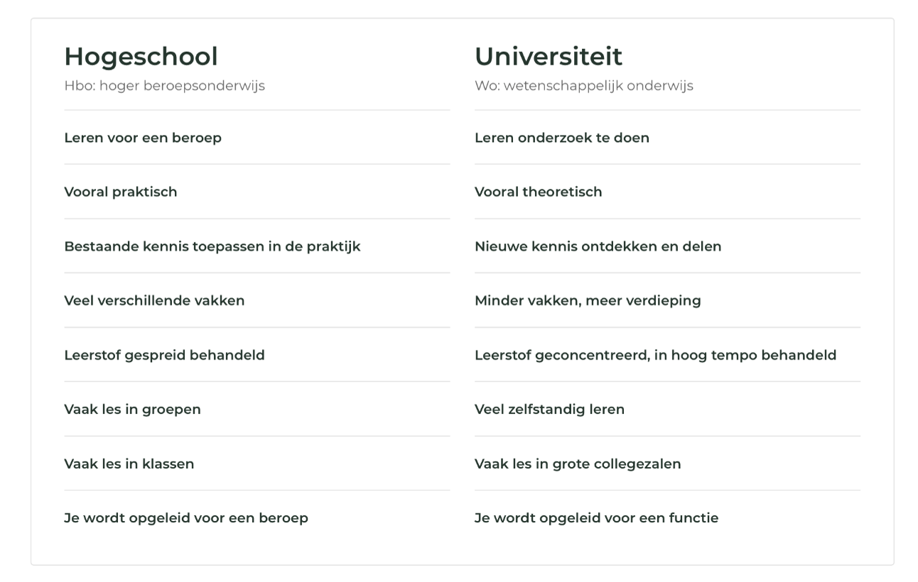

(Higher) education system
Bachelor
Source: studiekeuze123.nl
Read more about educational levels in NL:
https://www.nuffic.nl/en/education-systems/the-netherlands/level-of-dutch-diplomas

Slide 8
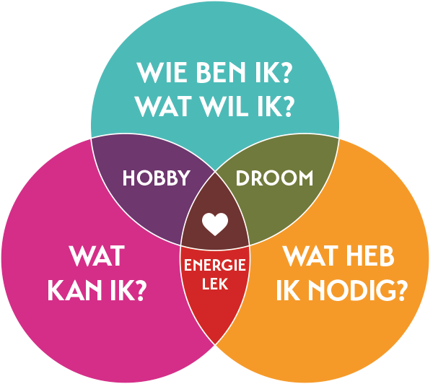
What courses to look for?
Consider your child's interests:
Explore what your child genuinely enjoys doing, whether it's school subjects or hobbies. What sparks their curiosity and enthusiasm?
Look at your child's talents:
Identify your child's strengths. What are they naturally good at? Are there particular skills or talents that stand out, such as creativity, compassion, analytical thinking, or communication?
Consider the learning style that suits your child:
Think about how your child learns best. Do they benefit from hands-on learning and practical activities, or do they thrive in a more theoretical, academic setting? Understand whether your child needs a lot of guidance or prefers more independent learning.
Understand your child's motivations:
Explore what drives your child. Are they motivated by personal achievement, helping others, financial security, or making a difference in the world? Knowing what truly motivates them can guide them toward a study choice that aligns with their core values and long-term goals.

Slide 9
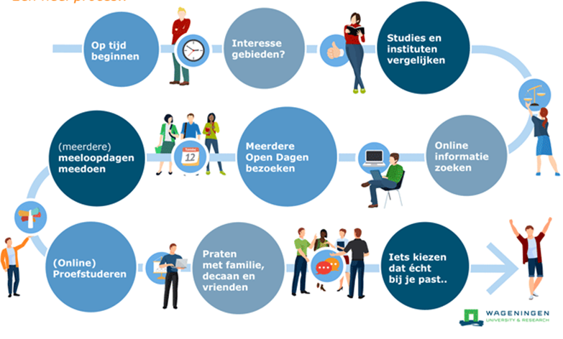

The searching process

Slide 10
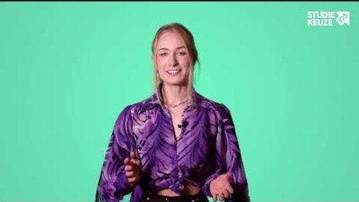
Where/how to look for courses
Studiekeuze123.nl
Kiesmbo.nl
bachelorsportal.com
wilweg.nl
lobhlmltto.com

Slide 11


Governmental funding for a course
Student finance in the Netherlands is calculated individually, as each student's situation is different. Factors such as parental income, living situation, and the type of education (MBO, HBO, or university) affect the amount a student is eligible to receive.
Calculate the funding:
https://duo.nl/particulier/rekenhulpen/rekenhulp-studiefinanciering.jsp
Webinar funding:
https://duo.nl/webinar/studiefinanciering-hoger-onderwijs-praktische-zaken.jsp

Slide 12

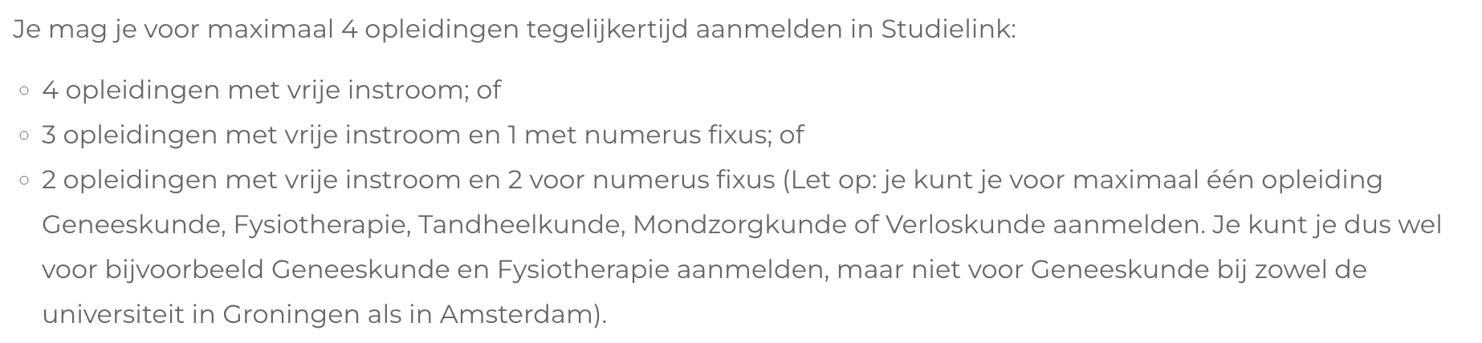

How to sign up for courses
HBO / WO
Studielink.nl
Log in through Digi-D
MBO
On the website of the MBO school

Slide 13
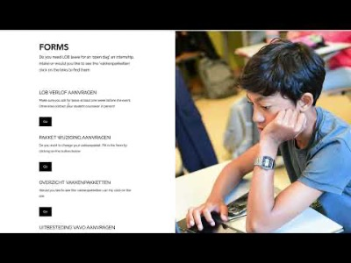
LOB activities at HLML
Mentor lessons all
Studiekeuze informatie avond (SKIA) H4/V5
Peer-2-Peer speeddate H5/V6
Visting open days / shadowing day all
ILP meetings all
Webinars all
How to ask for LOB leave

Slide 14
Important LOB related dates
Junior years (V4)
Activities:
27 November → webinar gapyear
Nov-Apr → 1 open day
2-3 December → ILP
25-26 February → ILP
Deadlines:
18 October → submitting course (package) change requests
1 April → deadline MBO
Junior years (H4/V5)
Activities
19-20 November → SKIA
27 November → webinar gapyear
Nov-Apr → 2 open days
2-3 December → ILP
25-26 February → ILP
Deadlines:
18 October → sign up SKIA
18 October → submitting course (package) change requests
1 April → Sign up MBO
Senior years (H5/V6)
Activities
25 September → peer-2-peer speeddate
27 November → webinar gapyear
Nov-Apr → open days / meeloopdagen
2-3 December → ILP
25-26 February → ILP
15 April → result Numerus Fixus
Deadlines:
15 January → sign up Numerus Fixus HBO/WO
1 April → sign up MBO
1 May → sign up HBO/WO
1 September → studiefinanciering DUO

Slide 15
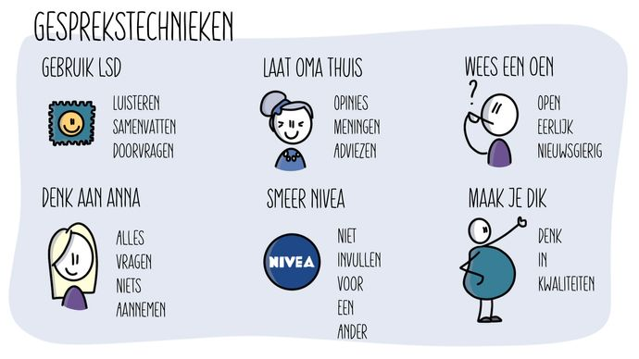

Tips for parents

Slide 16

Goodbye and questions
Natasja Jochems
n.jochems@haarlemmermeerlyceum.nl
Student counselor Havo
Art teacher
Patriek Tromp
p.tromp@haarlemmermeerlyceum.nl
Student counselor VWO
Economics teacher

